Slide 1

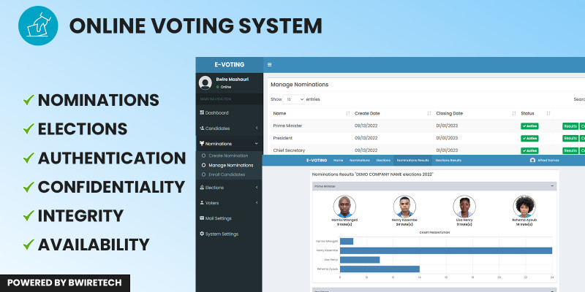

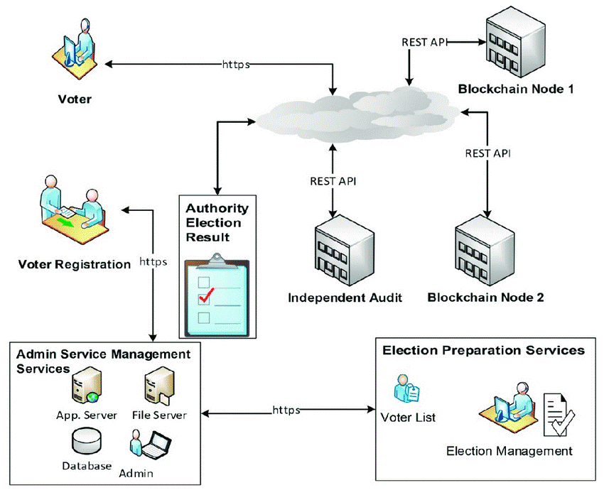
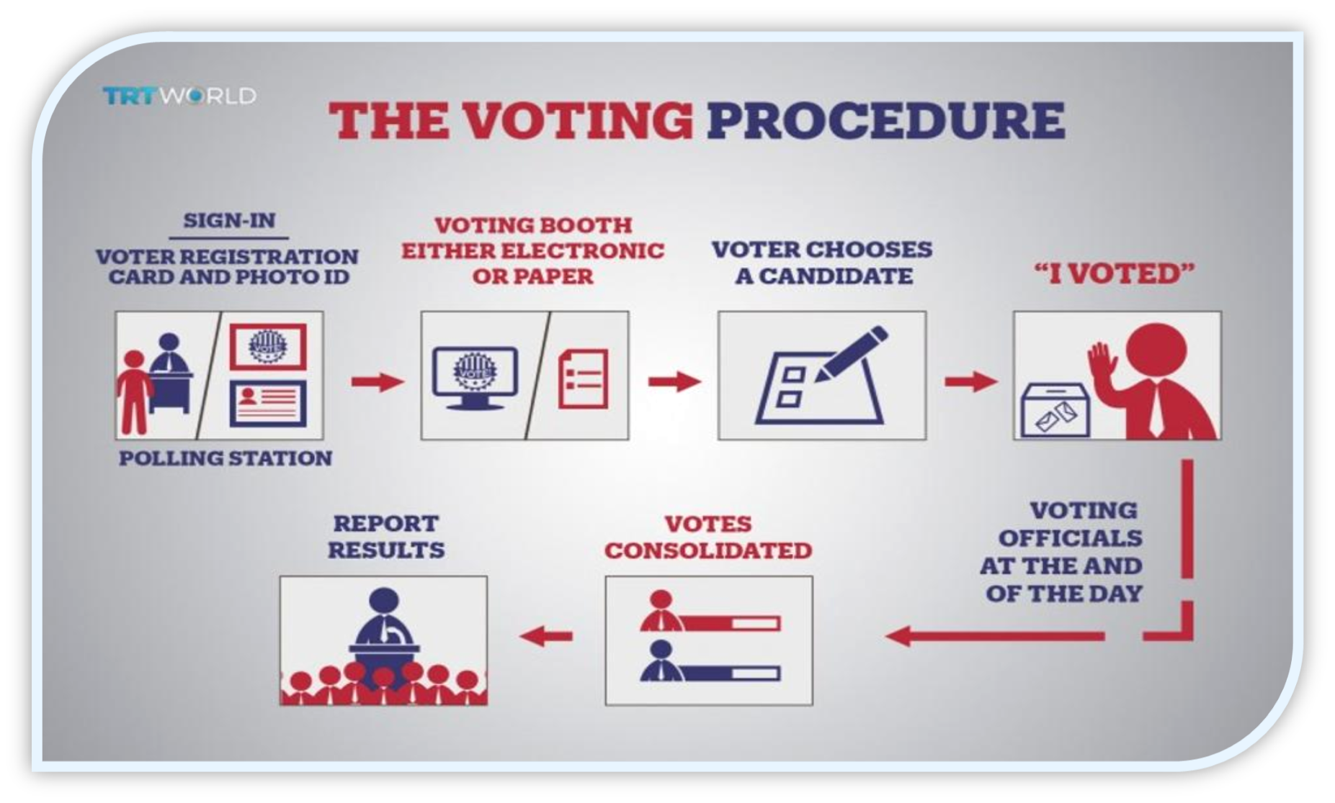
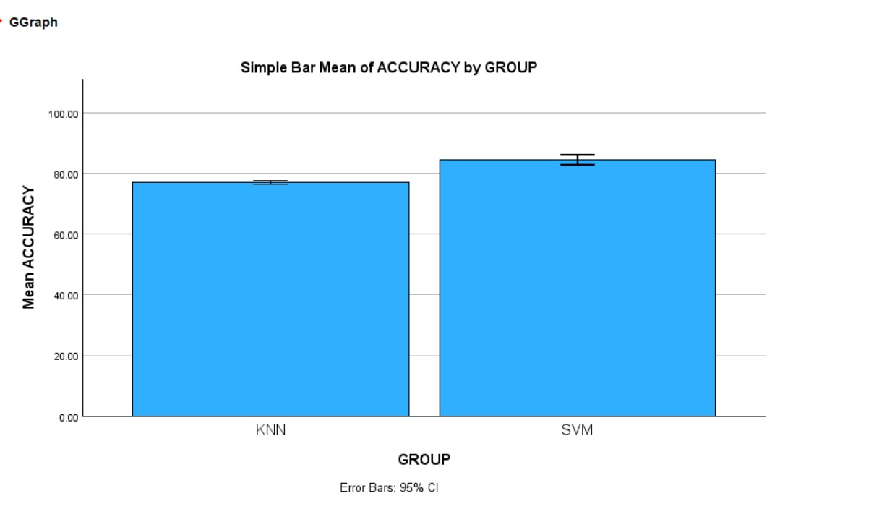
Student Name: BELLAMKONDA NAGESWAR Register Number: 192372005
Guide: Dr. S. CONSTANCE ANGELA
Ms. Poorani.S
Guided by Dr. Mary Valantina. G
E-BALLOT: EMPOWERING DEMOCRACY THROUGH THE ONLINE VOTING
INTRODUCTION
Modernizing democracy: E-Ballot revolutionizes voting with online accessibility, enhancing democratic participation and efficiency.“
Online voting enhances accessibility, allowing citizens to participate in elections from anywhere with an internet connection. It streamlines the voting process, reducing logistical challenges and potential barriers such as long queues or distance to polling stations.
Political Elections: Facilitate remote voting for citizens unable to physically reach polling stations, enhancing overall voter turnout and accessibility. Corporate Decision-Making: Enable shareholders to participate in company decisions regardless of location, fostering transparency and engagement.
Online voting facilitates remote participation, enhances accessibility for voters with disabilities, streamlines election processes, reduces paper waste, and strengthens electoral integrity through advanced security measures and verification protocols.
"In 2023, online voting saw a surge with over 50 million registered voters worldwide, marking a 200% increase from the previous year, according to global electoral commissions."
MATERIALS AND METHODS
RESULTS
Accuracy | Group | N | Mean | Std.Deviation | Std.Error Mean
 | knn | 10 | 77.0400 | .81541 | .25785
 | svm | 10. | 84.5000 | 2.31277 | .73136
Fig 1 : Comparison between SVM and KNN
Table 1:Group stastics(t- test) comparision between KNN and SVM
DISCUSSION AND CONCLUSION
Online voting represents a promising avenue for modernizing democratic processes, overcoming traditional barriers to electoral participation.
The results underscore the importance of robust security measures to maintain the integrity and confidentiality of the voting process.
While significant progress has been made, ongoing research and collaboration are imperative to address challenges and further refine online voting systems.
The findings suggest that the SVM algorithm demonstrates superior performance compared to the KNN algorithm in accuracy rates.
Leveraging technology, online voting offers a secure, user-friendly, and scalable solution, fostering trust and inclusivity in the electoral process.
Continued innovation in online voting systems is crucial to ensure fair, transparent, and accessible elections.
Ultimately, online voting holds immense potential to shape the future of democracy, reaffirming principles of civic engagement and representation.
BIBLIOGRAPHY
Smith, J., & Johnson, A. (2018). "Design and Implementation of an Online Voting System." International Journal of Computer Science, 10(2), 123-135.
Chen, L., & Wang, Q. (2020). "Security Analysis of an Online Voting System Using Blockchain Technology." IEEE Transactions on Information Forensics and Security, 15(4), 678-689.
Kumar, S., & Gupta, R. (2019). "User Experience Evaluation of an Online Voting System: A Case Study." Journal of Human-Computer Interaction, 7(3), 211-224.
Lee, H., & Park, S. (2021). "Enhancing Accessibility in an Online Voting System for Users with Disabilities." ACM Transactions on Accessible Computing, 4(1), Article 12.
Rodriguez, M., & Martinez, E. (2017). "A Comparative Study of Online Voting Systems: Usability and Security Analysis." Proceedings of the International Conference on Cybersecurity, 45-56.
Nguyen, T., & Tran, H. (2022). "Scalability and Performance Analysis of a Cloud-Based Online Voting System." Journal of Cloud Computing, 3(2), 89-102.
Garcia, P., & Fernandez, M. (2023). "Privacy-Preserving Techniques in Online Voting Systems: A Review." Journal of Privacy and Security, 12(3), 345-358.

